Slide 1
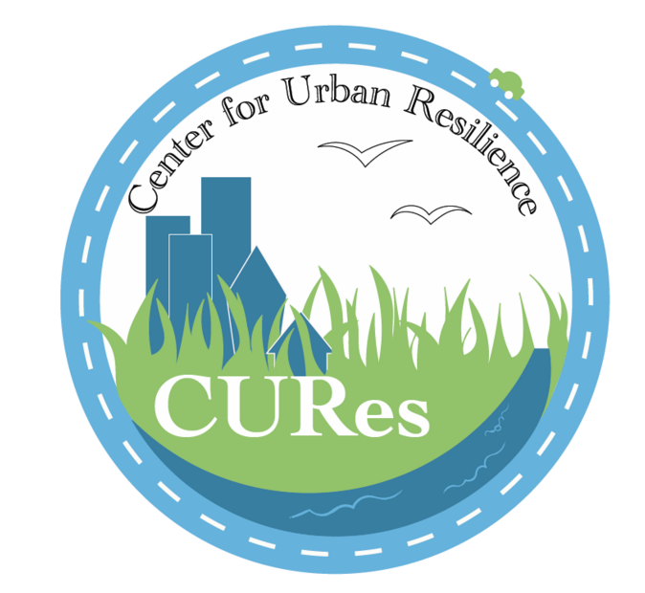
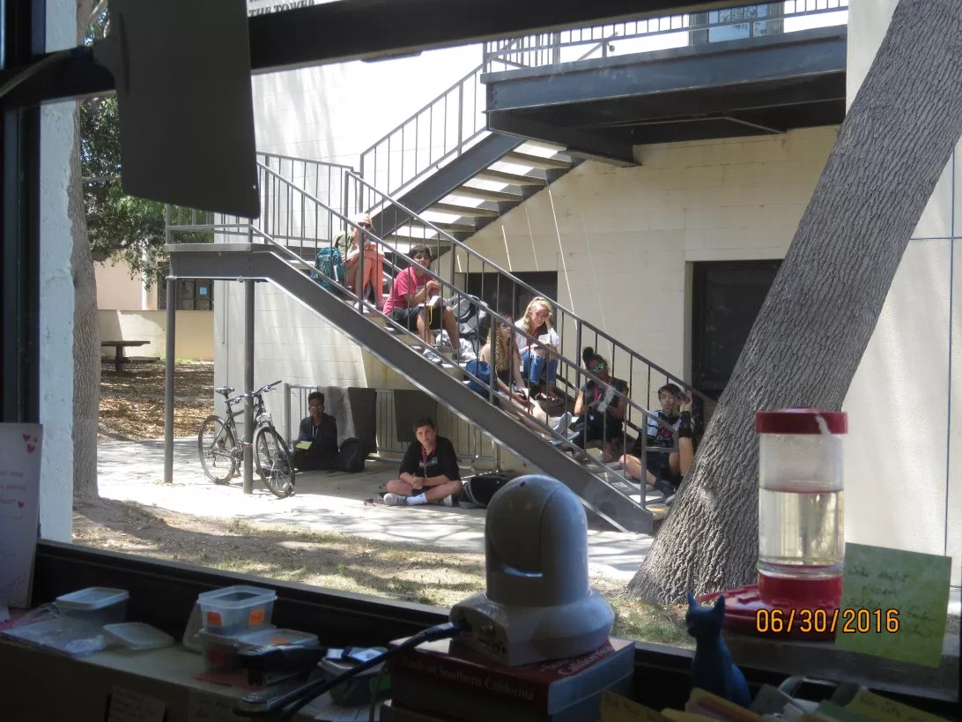
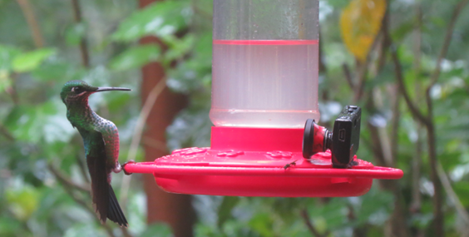
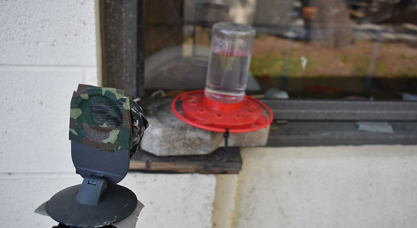
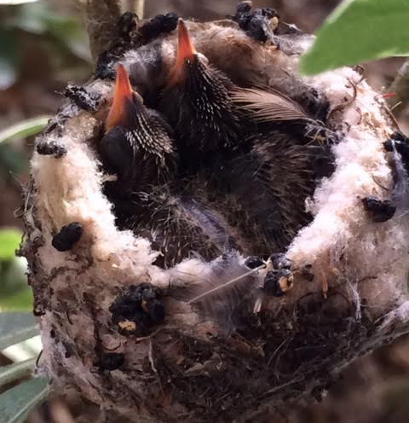
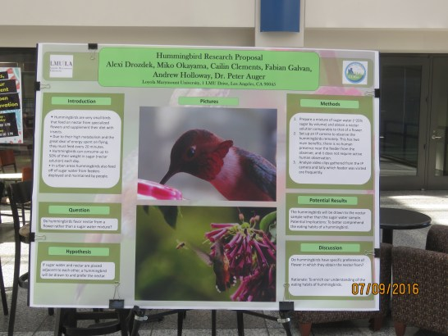
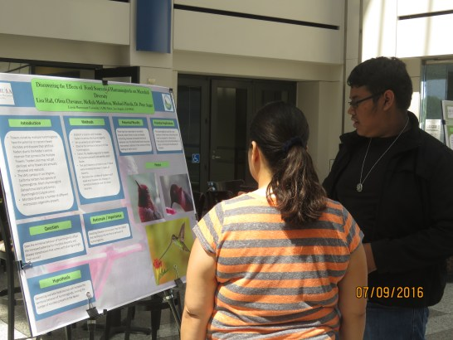
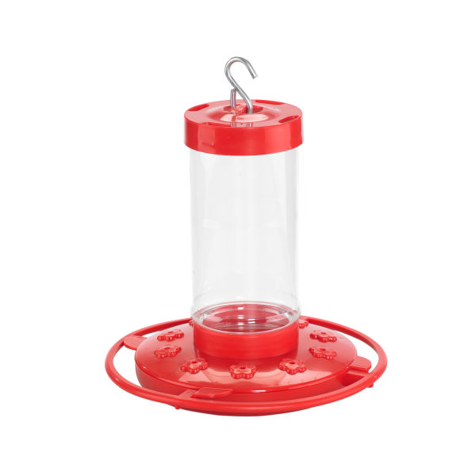
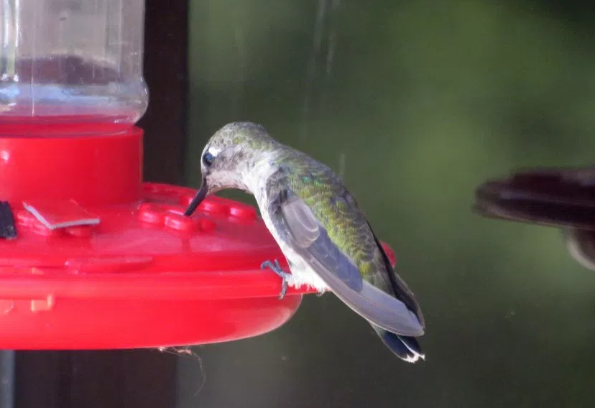
INTEGRATION OF HUMMINGBIRD RESEARCH INTO PUBLIC SCHOOL SCIENCE Kaitlyn Yee, Melissa Morado; E. Eberts, Dr. P. Auger, Dr. M. Romolini, Dr. E. Strauss Center For Urban Resilience | Loyola Marymount University | Spring 2017
Abstract
Pictures
Results
Hummingbirds are beautiful, acrobatic and mysterious synanthropes in urban ecosystems, providing important benefits to humans such as pollination, insectivory, and biophilia. However, environmental factors that affect behaviors that lead to such services are largely unknown, and could be altered by urbanization and climate change. Though their extremely high metabolism can make detailed observations of hummingbird behavior difficult, simple and low-cost methodologies, such as remote monitoring equipment deployed at feeders and nests, allow students at all levels of education to closely observe hummingbirds directly from their school sites. Through a partnership between the Center for Urban Resilience (CURes) and the Center for Equity for English Learners (CEEL) at Loyola Marymount University (LMU), these methodologies have begun to be implemented in various Los Angeles area schools and classrooms, through the CURes urban ecology curricula Urban EcoLab. Beyond enriching the understanding of how animals thrive in urban environments, we propose to develop a model that will facilitate the investigation of complex scientific questions through collaboration with citizen science and integration of the Urban EcoLab curricula into primary and secondary-level public school curricula.
The Ellen Ochoa Learning Center in Cudahy, California, grades 4-8, has implemented the study of hummingbirds into their science curricula.
In December of 2016, members of the CURes staff and undergraduate research students visited Ellen Ochoa to share ongoing hummingbird research, answer questions, and hear PSAs the student groups had prepared.
Students have developed an enthusiastic fascination about local hummingbirds in their communities.
Students observing the CURes hummingbird feeder.
Cameras at feeders.
[Picture from Ellen Ochoa]
Introduction
Two hummingbird posters by students in a precollege summer Environmental Science course at LMU.
Inquiry-Based Learning
Model that encourages students to ask complex questions and solve them using a hands-on way, with tools provided by an instructor.
Students will formulate their own questions, make their own hypotheses, and then begin their research and observation.
Inquiry-based learning allows students to not only ‘learn’, but also ‘do’ science.
Hummingbirds as a model for inquiry-based learning
These synanthropes are often overlooked, but on closer inspection, students find them fascinating and begin to formulate all sorts of questions about them.
Hummingbirds are common and easily observable from classrooms and school yards
Integrating field technology, such as thermal cameras and internet protocol (IP) cameras, will allow students to explore the physical and behavioral aspects of hummingbirds in an urban environment.
Discussion
Thermal images of a nesting female hummingbird.
Allen’s hummingbird chicks.
The PSAs show student engagement and understanding of important concepts linking hummingbird population decreases due to environmental and human-caused factors.
They understand that factors such as urbanization, coastal expansion of cities, use of pesticides, and destruction of habitat can have a detrimental impact on bird species like hummingbirds.
Students approached their research questions like scientists and were inspired by the CURes Lab research on the same subject.
CURes continues to recruit teachers to put hummingbird curriculum into more classrooms
We will update Urban EcoLab to add thermal imagery in classrooms to study metabolism, thermoregulation, physiology.
http://www.petworldshop.com/pictures/first-nature-hummingbird-feeder-starter-kit.jpg
Methods
Feeders
Mix 1:3 parts sugar and warm water to fill the feeder and replace every few days.
Remote monitoring
IP cameras, thermal imaging, and temperature data loggers are deployed at feeders and nests on LMU campus.
Working with teachers
Hummingbird feeder
Acknowledgements
The involvement of local L.A. schools with the CURes Lab is facilitated by CEEL, CURes Urban Ecolab teacher workshops, and the annual CURes Teacher Summer Institute.
Teachers are provided with equipment (hummingbird feeders) and comprehensive urban ecology curricula, including an entire Curriculum Unit on Hummingbirds that can be integrated into their school’s science curricula.
LMU’s Center for Urban Resilience
LMU’s Center for Equity for English Learners
Research Students at CURes Animal Behavior Lab
Students and Teachers at Ellen Ochoa Learning Center
Literature Cited
Male Allen’s Hummingbird feeding at the CURes feeder.
Female Anna’s hummingbird at Bird’s Nest feeder.

